Slide 1
HackSummit 2.0
Disaster Management
A Disaster is an event that occurs in most cases suddenly and unexpectedly, causing severe disturbances to people, objects and environment, resulting in loss of life, property and health of the population.

Slide 2
Disaster means a catastrophe, mishap, calamity or grave occurrence affecting any area from natural and manmade causes, or by accident or negligence, which results in substantial loss of life or human suffering or damage to, and destruction of property, or damage to, or degradation of environment and is of such a nature and magnitude as to be beyond the capacity of the community of the affected areas.
Disaster Risk: The potential disaster losses, in lives, health status, livelihoods, assets and services, which could occur to a particular community or a society over some specified future time period.
Disaster Risk Management: The systematic process of using administrative directives, organizations, and operational skills and capacities to implement strategies, policies and improved coping capacities in order to lessen the adverse impacts of hazards and the possibility of disaster.

Slide 3
Disaster Risk Reduction: The concept and practice of reducing disaster risks through systematic efforts to analyze and manage the causal factors of disasters, including through reduced exposure to hazards, lessened vulnerability of people and property, wise management of land and the environment, and improved preparedness for adverse events.
Sustainable Development: Development that meets the needs of the present without compromising the ability of future generations to meet their own needs.

Slide 4
GENERAL EFFECTS OF DISASTER
LOSS OF LIFE
INJURY
DAMAGE TO AND DESTRUCTION OF PROPERTY.
DAMAGE TO AND DESTRUCTION OF PRODUCTION.
DISRUPTION OF LIFESTYLE
LOSS OF LIVELIHOOD.
DISRUPTION TO ESSENTIAL SERVICES
DAMAGE TO NATIONAL INFRASTRUCTURE
DISRUPTION TO GOVERNMENTAL SYSTEMS
NATIONAL ECONOMIC LOSS
SOCIOLOGICAL AND PSYCHOLOGICAL AFTER EFFECT.

Slide 5
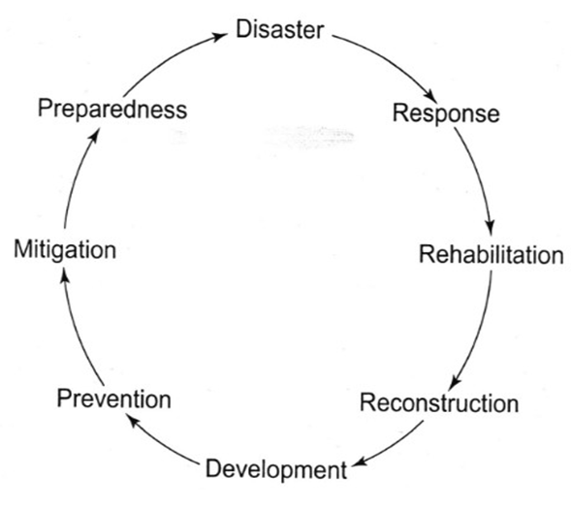
DISASTER MANAGEMENT CYCLE

Slide 6
PREVENTION & MITIGATION
Prevention : Action within this segment is designed to impede the occurrence of a disaster event and/or prevent such an occurrence having harmful effects on communities or key installations.
Mitigation : Action within this segment usually takes the form of specific programs intended to reduce the effects of disaster on a nation or community. For instance, some countries regard the development and application of building codes (which can reduce damage and loss in the event of earthquakes and cyclones) as being in the category of mitigation.

Slide 7
PREPAREDNESS
Preparedness is usually regarded as comprising measures which enable governments, organizations, communities and individuals to respond rapidly and effectively to disaster situations.
Examples of Preparedness measures are :
The formulation & maintenance of valid, up-to-date counter- disaster plans
Special provisions for emergency action
The provisions of warning systems
Emergency communications
Public education and awareness
Training programs, including exercises and tests.

Slide 8
Principles of Disaster Management
Planning :
to have a clear and logical approach to dealing with disasters.
to provide common reference for all departments and authorities with roles.
to assist with information for sitting-up a multi- functional organizational structure.
to form a basis for coordinated action.
to provide clear allocation of responsibilities.
to form a basis for reviewing and evaluating current and future disaster management requirements.
to give a focus for disaster related training.

Slide 9
Organization:
the nature of National Disaster Management Authority (NDMA)
Utilization of total governmental structures/ resources i.e. National, State & Local level.
Co-ordination of non governmental resources
Community involvement
Resource Utilization:
Identification of resources
Assessment of resources with relation to their capability & availability
Allocation of appropriate tasks
Level of skill in handling allotted tasks and experience
Activation time for deployment/availability
Co-ordination with line authorities of resource organizations
Coalition of accurate information for effective deployment of
resources

Slide 10
PLAN DEVELOPMENT:
Steps in a collaborative planning process include –
formation of team,
understanding hazards, vulnerabilities and risk in the district,
plan development (develop and analyze course of action, identify resources, identify information needs),
plan preparation (write, review, approve and disseminate)
plan implementation and maintenance (exercise, review, revise and maintain).

Slide 11
AGENCIES:
Governmental (Including Military both at National & State Level).
Non Governmental Organizations.
Community groups both social & religious.
International Volunteer organization.

Slide 12
CENTRAL GOVERNMENT:
Sl. No | Name of the Dept. | Role of the Dept. in brief
1 | NDRF | Deployment of rescue teams with rescue equipment for rescue and relief operation
2 | Army | Deployment of Army personnel for rescue and relief operation
3 | Indian Navy | Deployment of Rescue Team Rescue boats, rescue equipment Contact person details
4 | Coast Guard | Deployment of Rescue Team Deployment of life boats Contact person details
3 | Indian Railways | Protection of railway lines, Running of spl. Trains Providing of food, water to the stranded passengers
4 | BSNL | Ensure communication network in the affected areas Restoration of network, functioning of cell towers, landline communication etc Supply of generators at cell towers
5 | All Inida Radio | creation of wide publicity release of news bulletins
6 | Cyclone Warning Centre | release of bulletins/ warning contact details
7 | FCI | Supply of food grains to the Civil Supplies Dept. as per the requirement

Slide 13
INVENTORY OF RESCUE & RELIEF:
The inventory has been uploaded in the NDMA IDRN portal (India Disaster Resources Network) http://idrn.gov.in
Roads & Buildings Dept.
JCBs. , Bull Dozers, Power Saws, Tree Cutting equipment
2. Road Transport Dept.
Trucks, buses, jeeps
Fire Services Dept.
Fire Fighting equipment, heavy cutters, life save jackets, ropes
Water Supply Dept.
Water Tanks, water cans, water plants

Slide 14
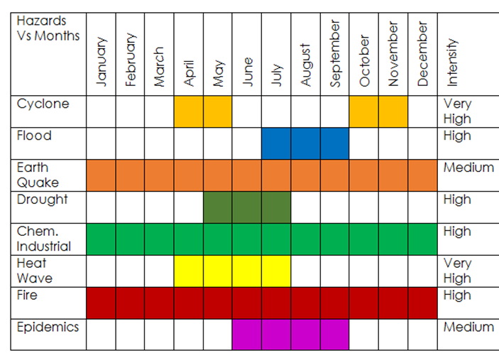
SEASONAL CALENDAR

Slide 15
Areas of Concern:
Activating an Early Warning System network and its close monitoring
Vulnerability of critical infrastructures (power supply, communication, water supply, transport, etc.) to disaster events
Funding: Primacy of relief as disaster response
Sustainability of efforts
Emergency medicine, critical care medicine, triage, first aid
Lack of integrated efforts to collect and compile data, information and local knowledge on disaster history and traditional response patterns.

Slide 16
NODAL AGENCIES FOR DISASTER MANAGEMENT
Floods : Ministry of Water Resources, CWC
Cyclones : Indian Meteorological Department
Earthquakes : Indian Meteorological Department
Epidemics : Ministry of Health and Family Welfare
Avian Flu: Ministry of Health, Ministry of Environment,
Ministry of Agriculture and Animal Husbandry
Chemical Disasters : Ministry of Environment and Forests
Industrial Disasters : Ministry of Labour
Rail Accidents : Ministry of Railways
Air Accidents : Ministry of Civil Aviation
Fire : Ministry of Home Affairs
Nuclear Incidents : Department of Atomic Energy
Mine Disasters : Department of Mines

Slide 17
FUTURE DIRECTIONS
Encourage and consolidate knowledge networks
Mobilize and train disaster volunteers for more effective preparedness, mitigation and response (NSS, NCC, Scouts and Guides, NYK, Civil Defense, Home guards)
Increased capacity building leads to faster vulnerability reduction.
Mobilizing stakeholder participation of Self Help Groups, Women's Groups, Youth Groups, Panchayati Raj Institutions.
Anticipatory Governance: Simulation exercises, Mock drills and Scenario Analysis
Knowledge Management: Documentation and dissemination of good practices

Slide 18
FUTURE PLANS:
ALL DEPARTMENTS SHOULD HAVE THEIR OWN PLAN OF MITIGATION
ALL DEPARTMENT PLANS SHOULD BE INTEGRATED IN THE DDMP
THE DDMP SHOULD BE INTEGRATED WITH HISTORY OF CYCLONES, GEOGRAPHICAL AREAS, LATITUDE/LONGITUDE DETAILS, CONTACT NUMBERS, INVENTORY DETAILS, MANDAL MICRO PLANS ETC.

Slide 19
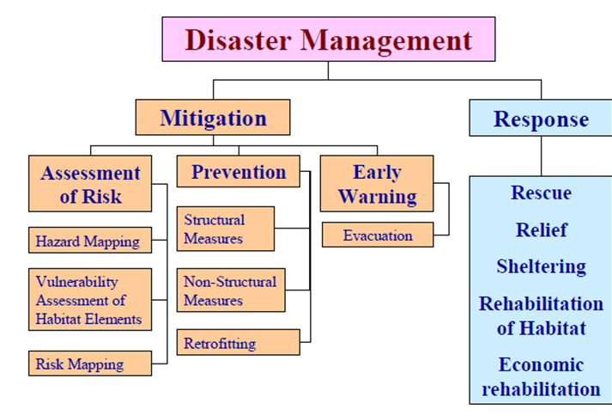
OBJECTIVES OF THE DDMP:
To identify the areas vulnerable to major types of the hazards in the
district.
To adopt proactive measures at district level by all the govt. departments to prevent disaster and mitigate its effects.
To define and assign the different tasks and responsibilities to stakeholders during the pre-disaster and post-disaster phases of the disaster.
To enhance disaster resilience of the people in the district by way of capacity building.
Reduce the loss of public and private property, especially critical
facilities and infrastructure, through proper planning.
Manage future development to mitigate the effect of natural hazards in the district.
To set up an Emergency Operations Centre at the District level to function effectively in search, rescue, response.
To develop the standardized mechanism to respond to disaster situation to manage the disaster efficiently.

Slide 20
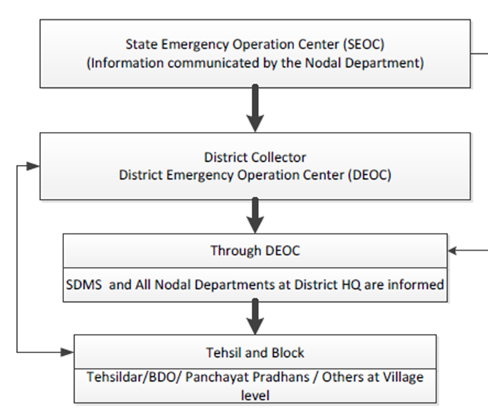
COMMUNICATION FLOWCHART:

Slide 21
KEY ISSUES:
Priority during 'non-disaster' phase
Inventory management
Maintenance of equipment
Inter-institutional coordination
Operationalization of EOCs
Community involvement
Role of PRIs and ULBs

Slide 22
THANK YOU
TEAM MEMBERS:
OM SURYAVANSHI (LEADER)
KARTHEEK KARRA
KARTIK GUPTA
PRATEEK VERMA

